Slide 1
Wind power production forecast using random forest
22 Aug 2018
Christopher Coello

Slide 2
Wind RF
Objective: overview of a ML use case at Thomson Reuters
5 min about AI/ML/DL
Use case: wind power production forecast in Germany (DEU)
Input data
Model selection
Optimisation
Validation

Slide 3
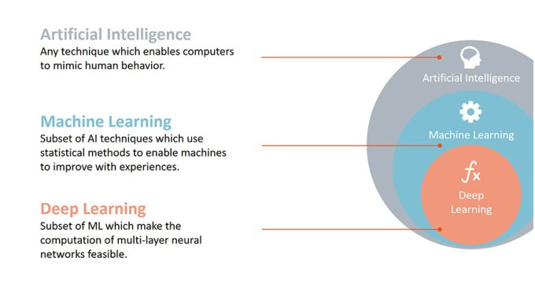
Artificial Intelligence (AI) / Machine learning (ML) / Deep learning (DL)
Shallow models
Deep models

Slide 4
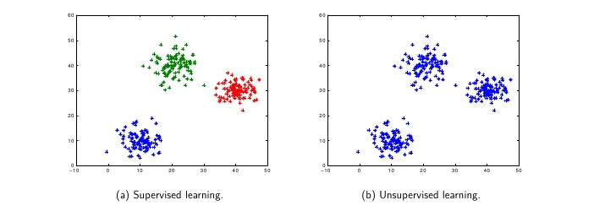
Unspervised vs. Supervised models
cluster analysis

Slide 5
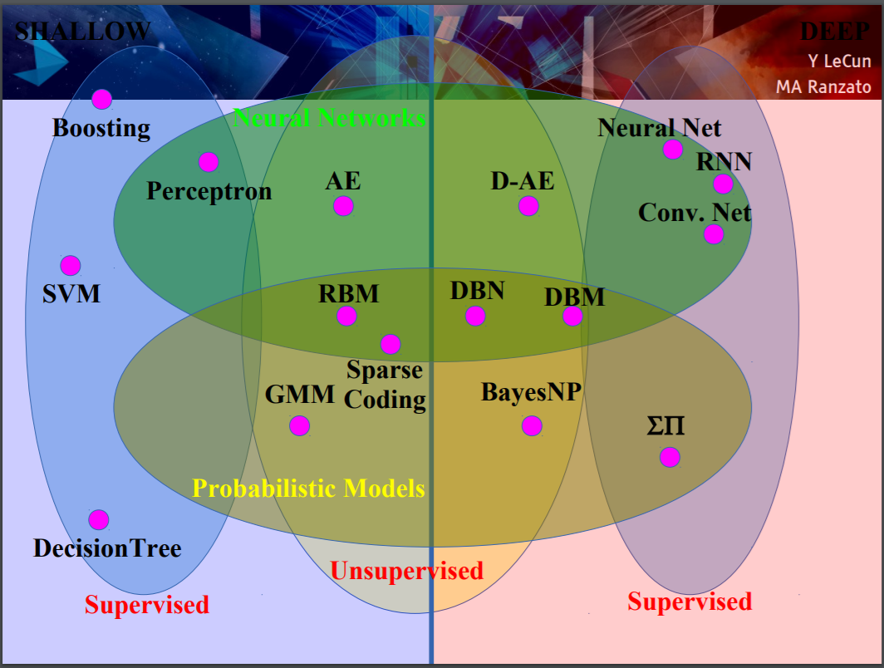
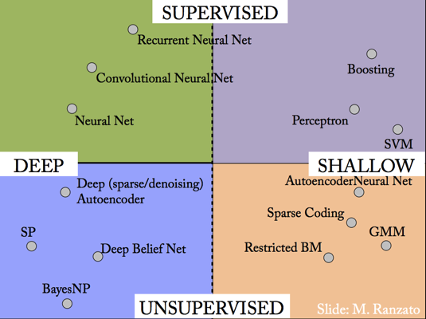
One model to rule them all... or not
Y. LeCun, MA Ranzato, ICML 2013

Slide 6
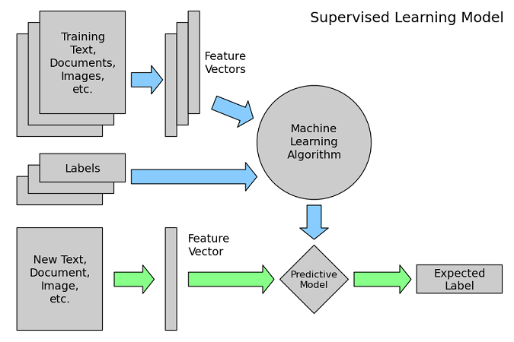
ML learning process
Scikit-learn help doc
training
prediction

Slide 7
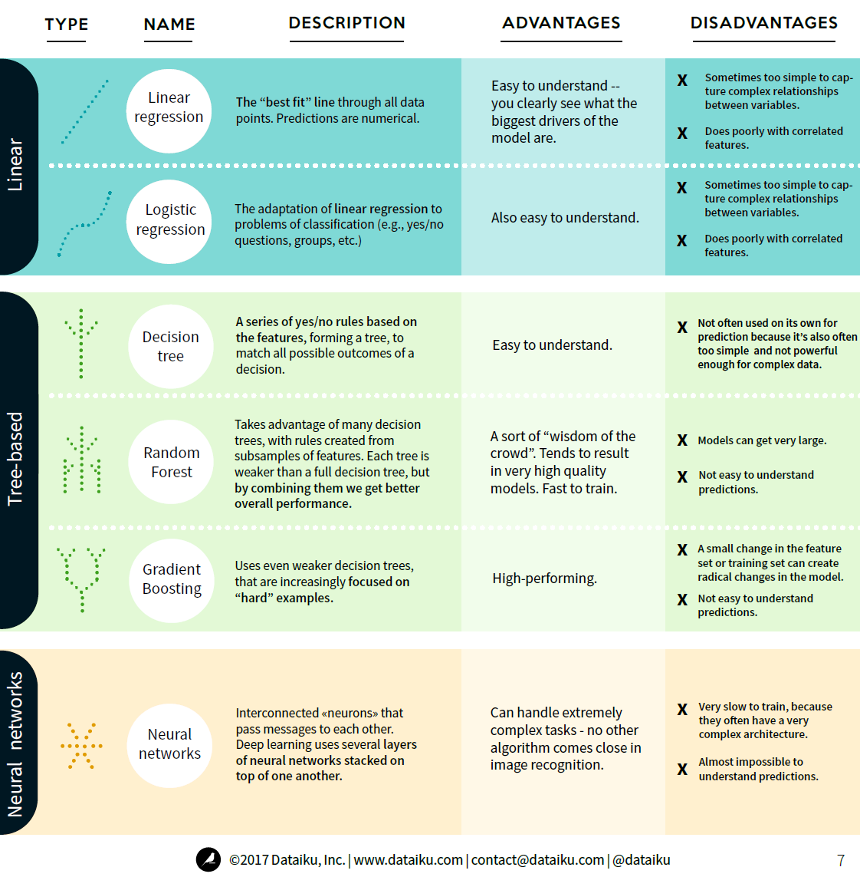
Supervised learning
MACHINE LEARNING BASICS
An Illustrated Guide for Non-Technical Readers
Website of Dataiku : www.dataiku.com
15 pages PDF.

Slide 8
Wind RF
Objective: overview of a ML use case in Thomson Reuters
5 min about AI/ML/DL
Use case: wind power production forecast in Germany (DEU)
Input data
Model selection
Optimisation
Validation

Slide 9
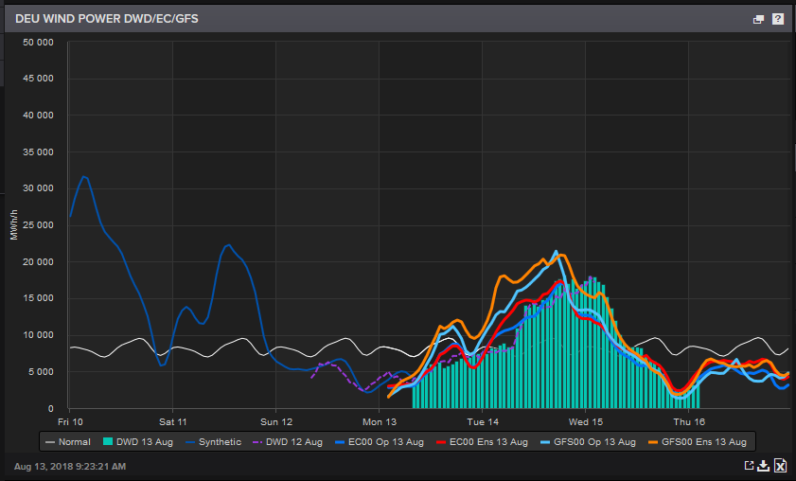
Use case: wind power forecast in Germany
We predict the hourly wind power production in Germany and other countries worldwide for the days ahead based on different weather forecasts.

Slide 10
Use case: wind power forecast in Germany
General presentation of the model
Actual/real wind speed at each windmill
Forecast wind speed at each windmill
Model
Model
Actual/real wind production at each windmill
Forecast wind production at each windmill
training
prediction

Slide 11
Use case: wind power forecast in Germany
General presentation of the model
Actual/real wind speed at weather stations
Forecast wind speed at weather stations
Model
Model
Actual/real wind production at regional level
Forecast wind production at regional level
training
prediction

Slide 12
Use case: wind power forecast in Germany
General presentation of the model
Forecast wind speed at weather stations
Kalman filter
Actual/real wind speed at weather stations
Filtered forecast wind speed at weather stations
Model
Model
Actual/real wind production at regional level
Forecast wind production at regional level
training
prediction

Slide 13
Use case: wind power forecast in Germany
General presentation of the model
Forecast wind speed at grid level
Forecast wind speed at grid level
Model
Model
Actual/real wind production at regional level
Forecast wind production at regional level
training
prediction

Slide 14
Wind RF
Objective: overview of a ML use case in Thomson Reuters
5 min about AI/ML/DL
Use case: wind power production forecast in Germany (DEU)
Input data
Model selection
Optimisation
Validation

Slide 15
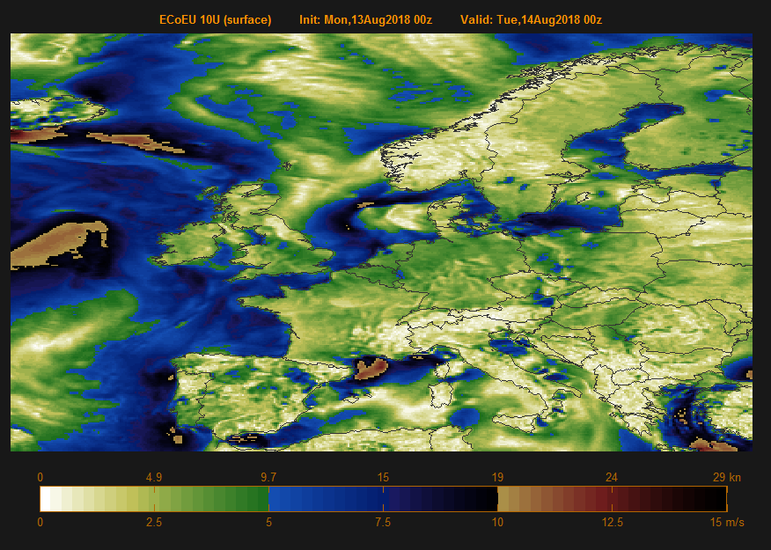
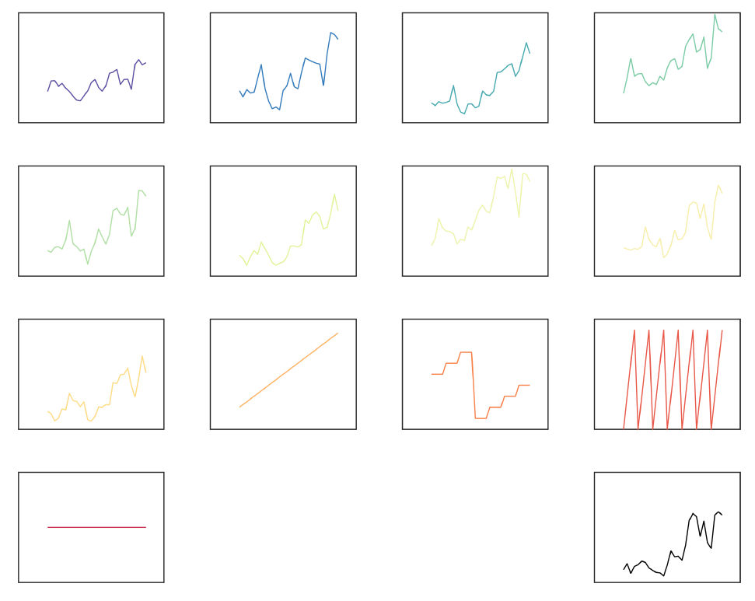
Use case: wind power forecast in Germany
Input data: wind speeds
Wind speed (m.s⁻¹)
time (h)
Wind speed (m.s⁻¹)
time (h)
Wind speed (m.s⁻¹)
time (h)

Slide 16
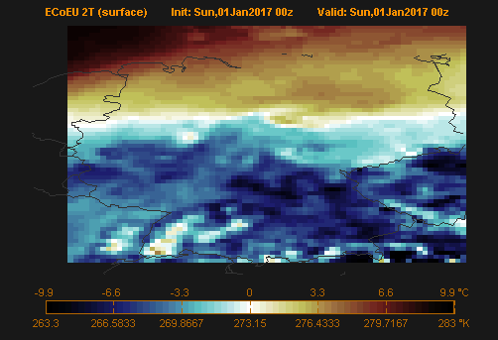
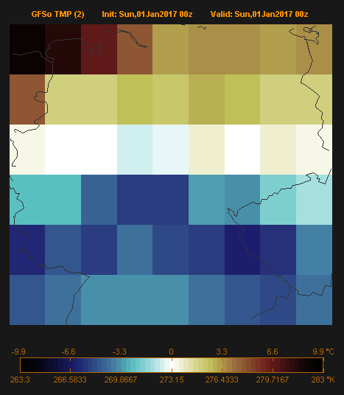
Use case 1: wind power forecast in DEU
Features (X): predictor variable, observable quantity
Weather data
Forecasts
ECoEU (0.125°) + Germany bounding box
61 latitude points
74 longitude points
4514 available time-series
(1°)

Slide 17
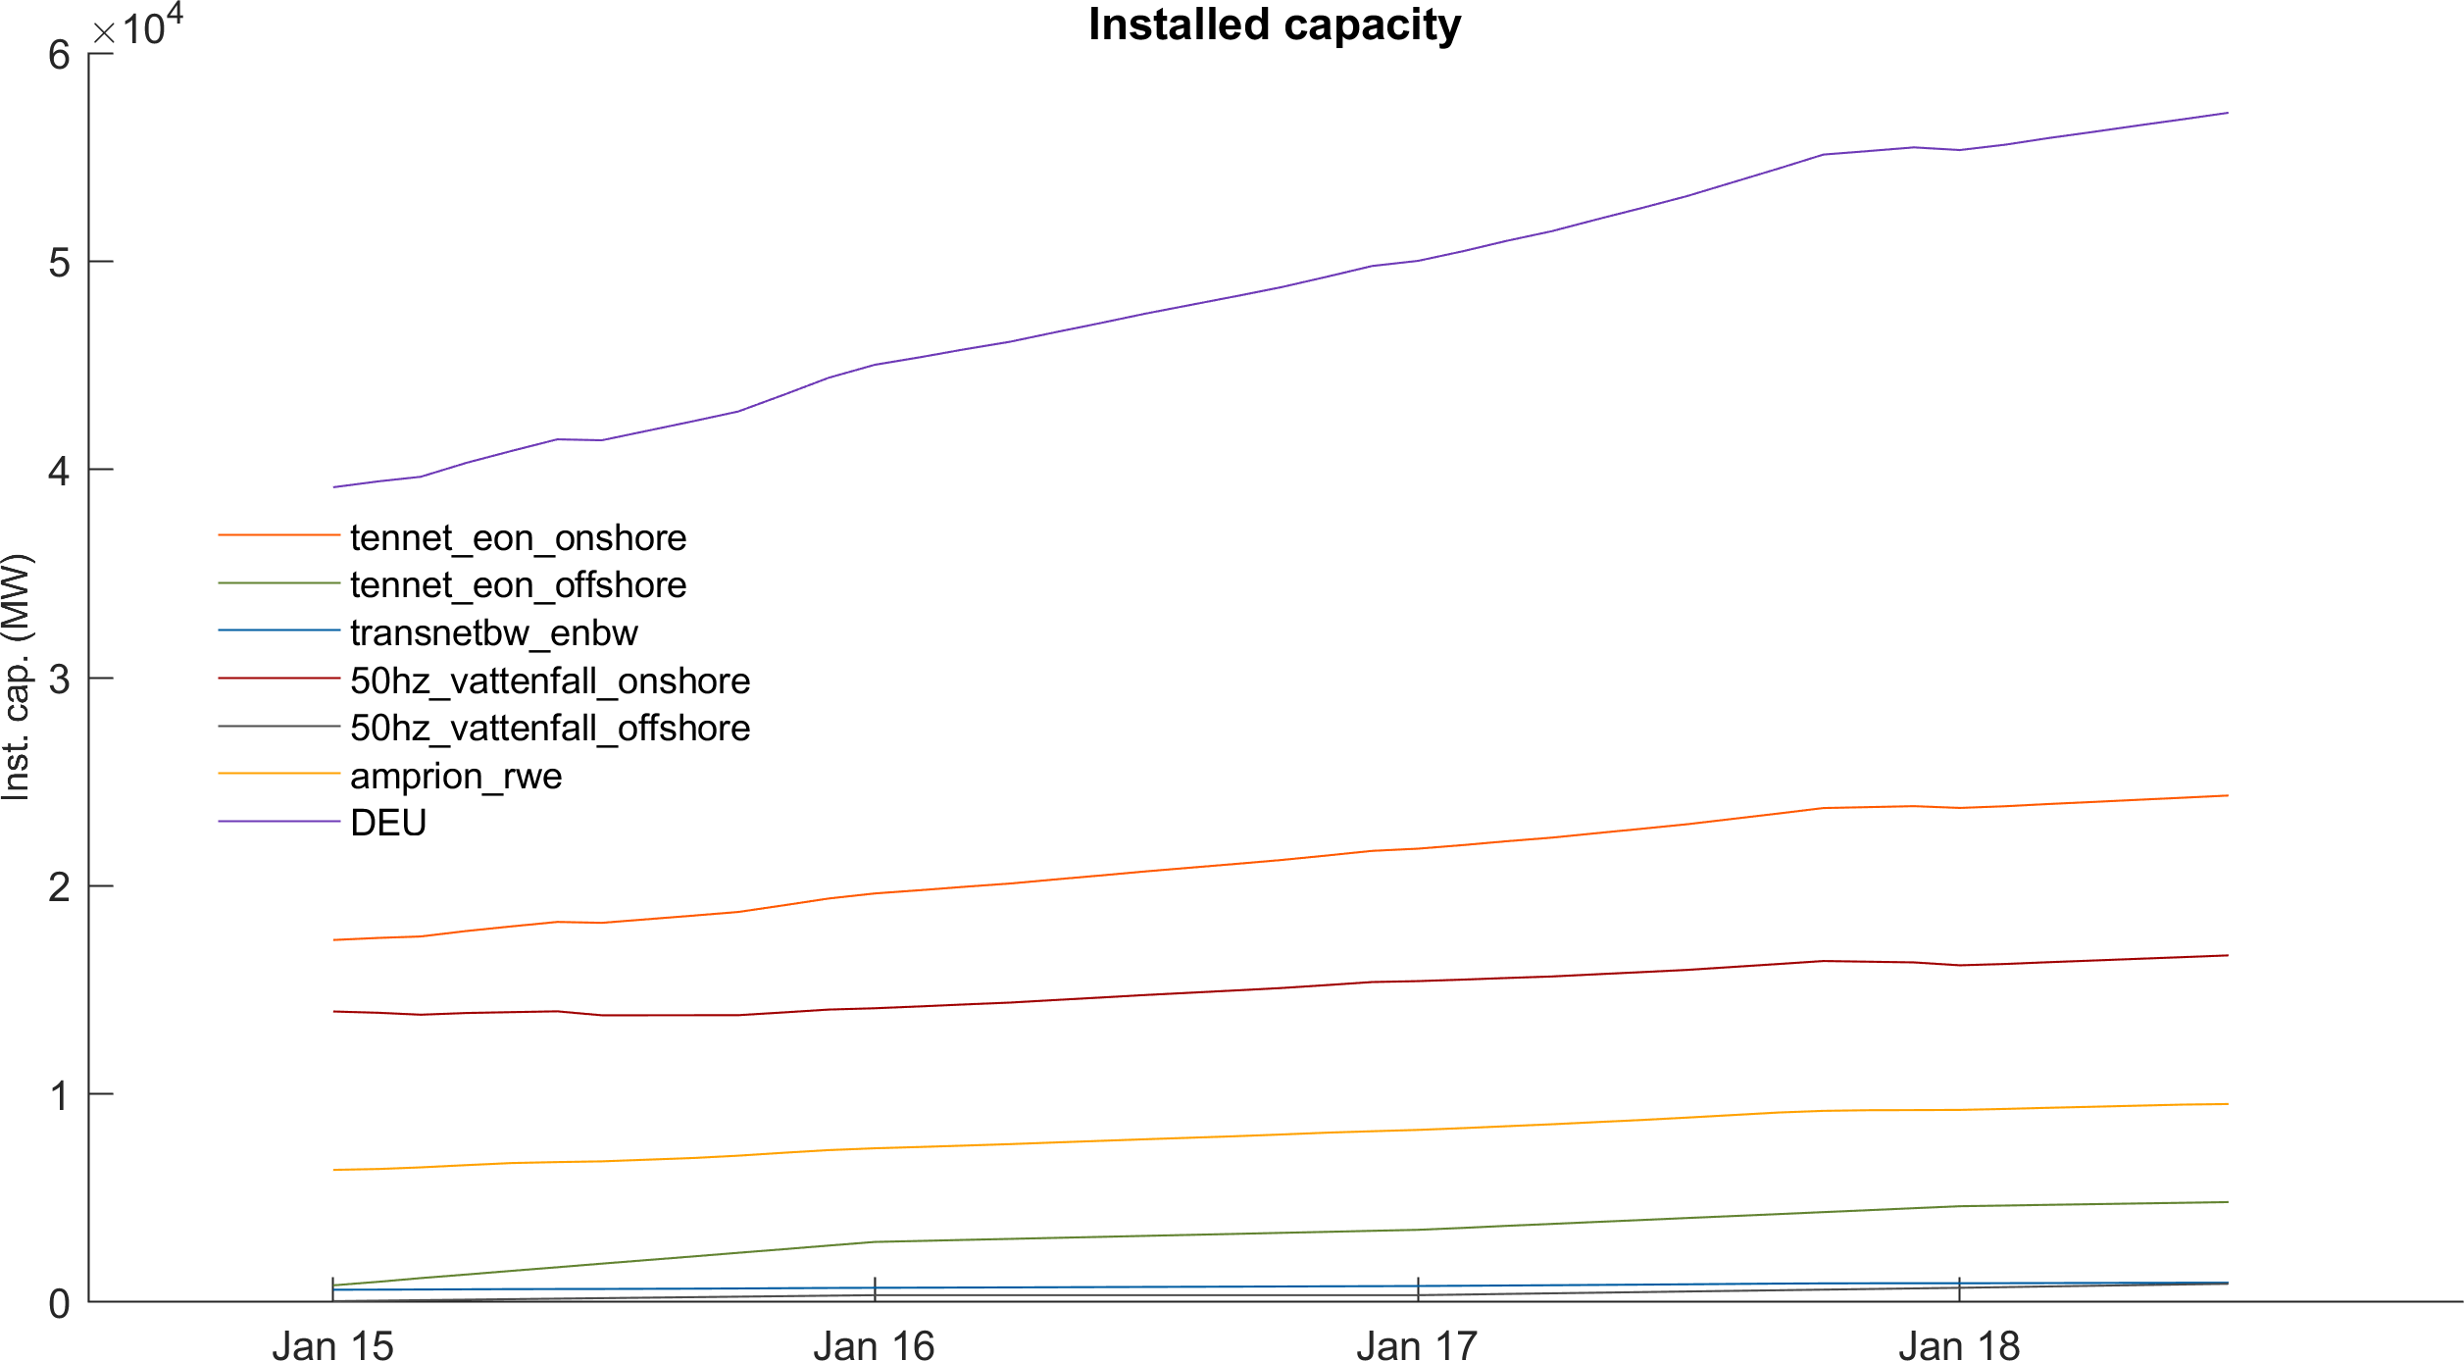
Use case 1: wind power forecast in DEU
Features (X): predictor variable, observable quantity
Installed capacity

Slide 18
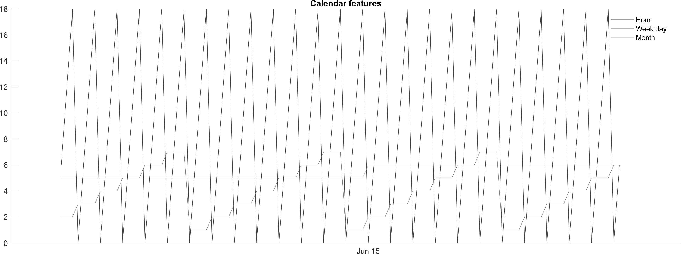
Use case 1: wind power forecast in DEU
Features : predictor variable, observable quantity
Calendar features

Slide 19
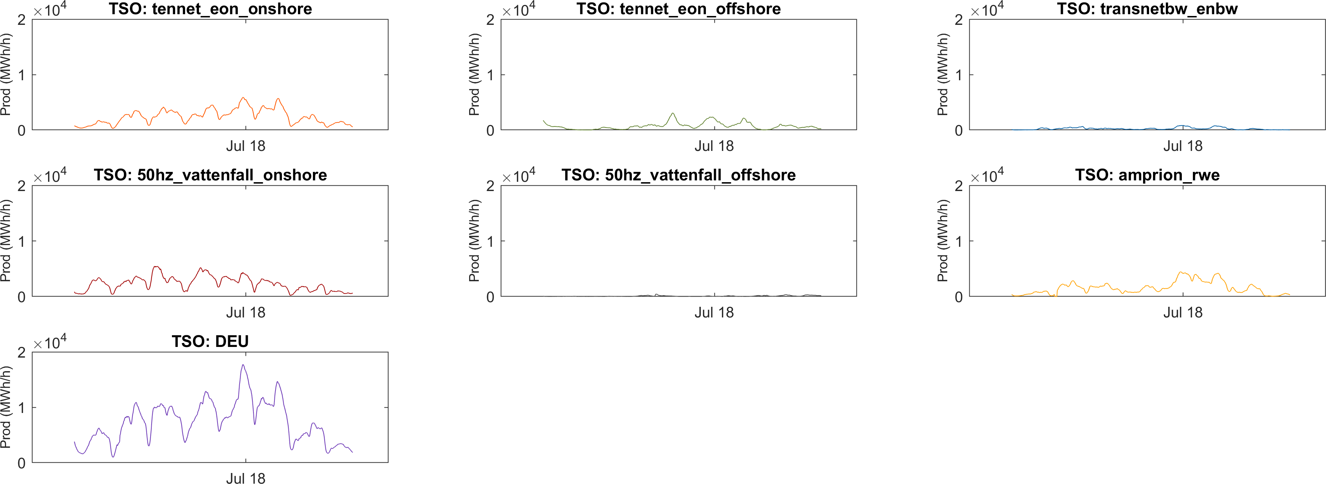
Use case 1: wind power forecast in DEU
Target variable (Y) : output we wish predict, hourly time serie

Slide 20
Use case 1: wind power forecast in DEU
Couple of data wrangling steps later...
Downsampling weather data
- how many grid points are averaged to generate the new point. Example right -> went from 4514 points to 9 points
Combining dates
- forecast : six hourly, production: more precise (15min, hourly,etc...) -> subsample production to forecast
For three years (2015, 2016 and 2017), 4382 time points available for training the model

Slide 21
Wind RF
Objective: overview of a ML use case in Thomson Reuters
5 min about AI/ML/DL
Use case: wind power production forecast in Germany (DEU)
Input data
Model selection
Optimisation
Validation

Slide 22

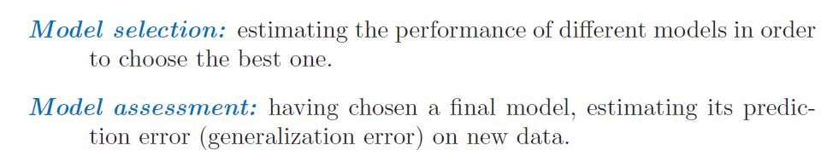

Model selection vs assessment
The ISL
The ESL

Slide 23
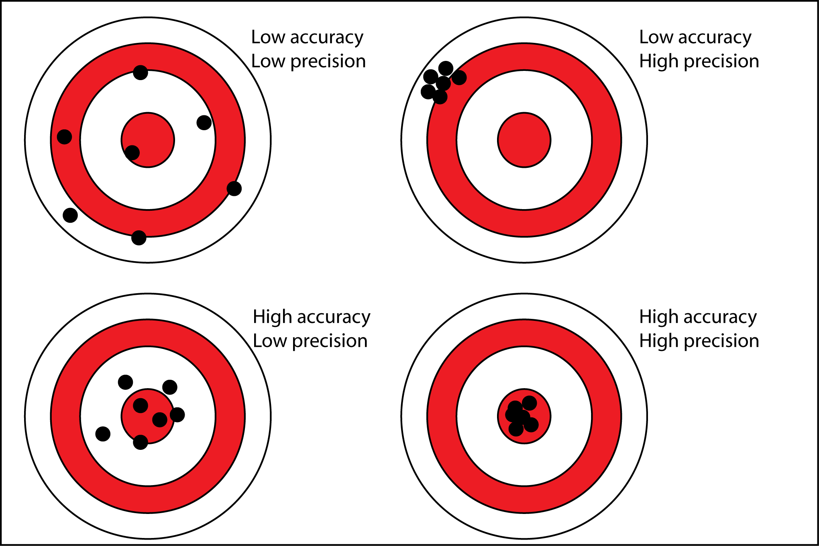
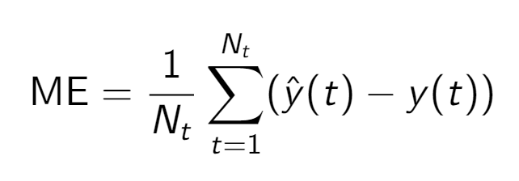
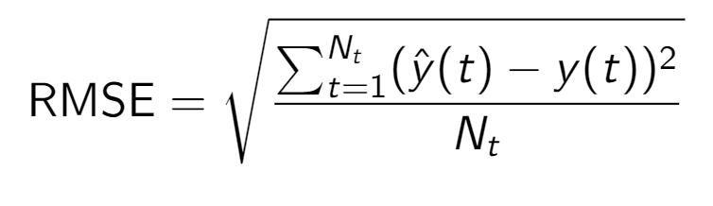
Model selection: cost function
Accuracy
Metric of how wrong the model is

Slide 24
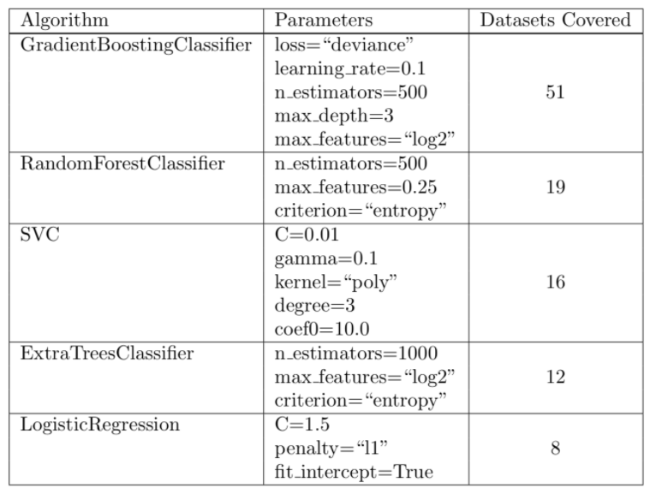
Model selection: models
HAVE A BASELINE
Run the «fantastic four/five» algorithms
Random Forest
XGBoost
Logisitic regression
Support Vector Machine
Do not only look at the accuracy
Execution time
Framework existing in your company (Java, Spark, Scikit-Learn, R, Matlab,...)
Ease of implementation
Ease of explanation to clients
Experience of the team
https://arxiv.org/abs/1708.05070

Slide 25
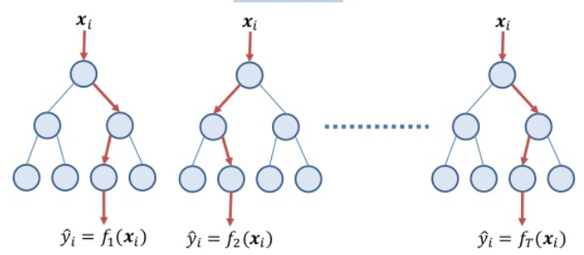
Model selection: random forest
Random forest
- An ensemble of decision trees trained by bootstrap sampling and random feature selection
1.
2.
3.
Number of trees (N_{T})
A decision tree is flow-chart structure where each node denotes a test on an attribute (spltting criteria)
Each tree is ran with a subsample of the data
The data not used is called the out of bag (oob) data and is used to estimate out of sample / out of bag error
Each tree’s input x_{i} is a vector of random sub-selection of the features (numPTS)
Tree depth

Slide 26
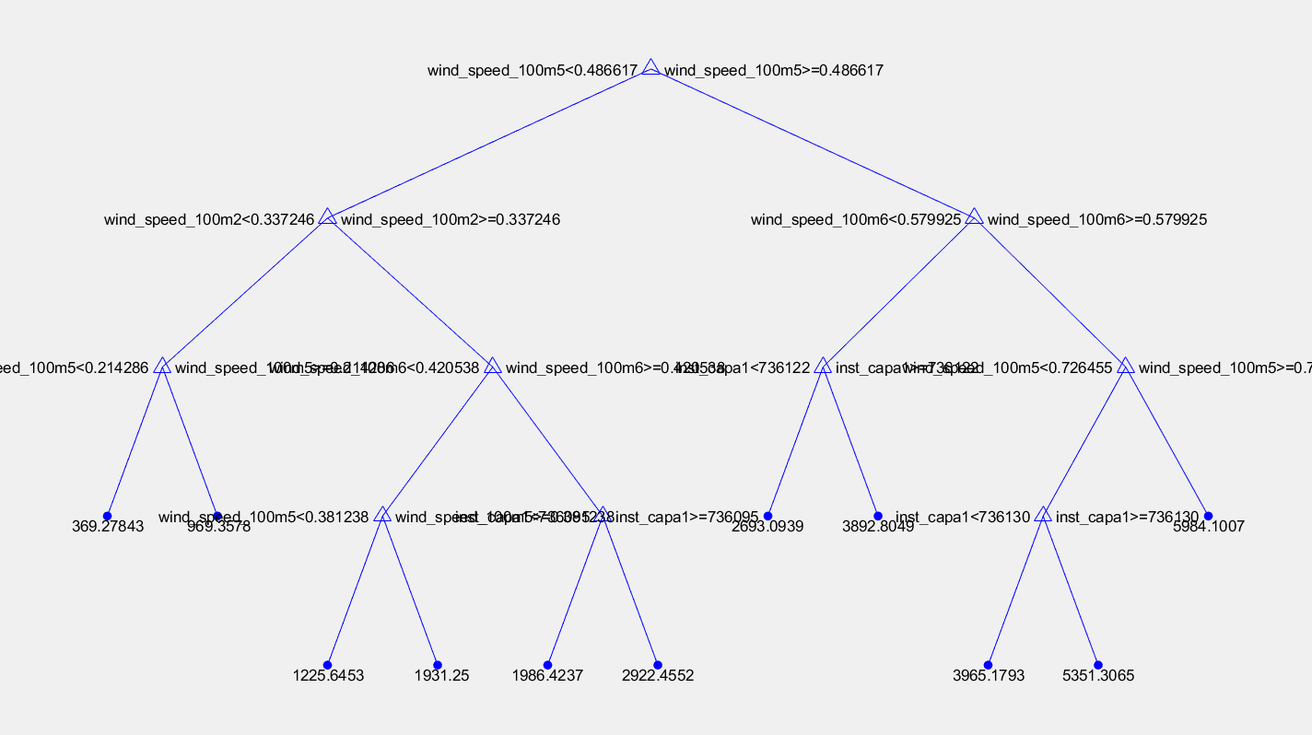
Model selection : random forest
A decision tree

Slide 27
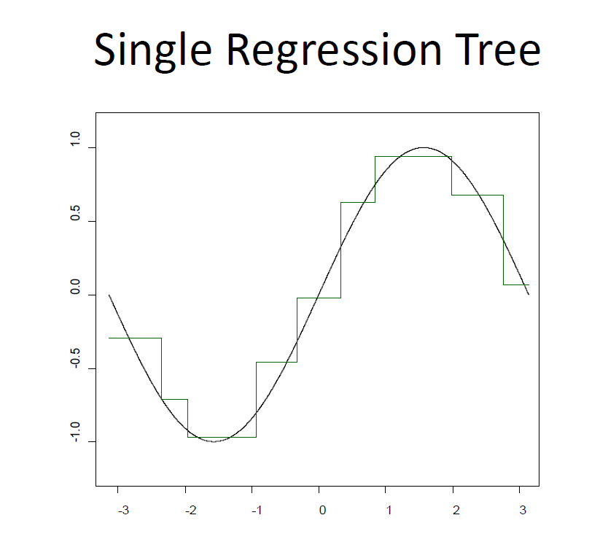
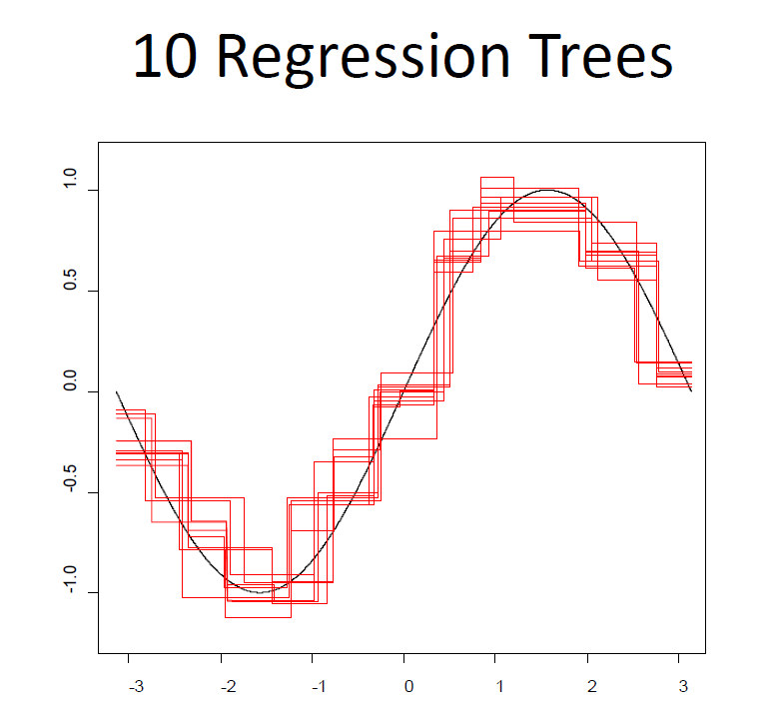
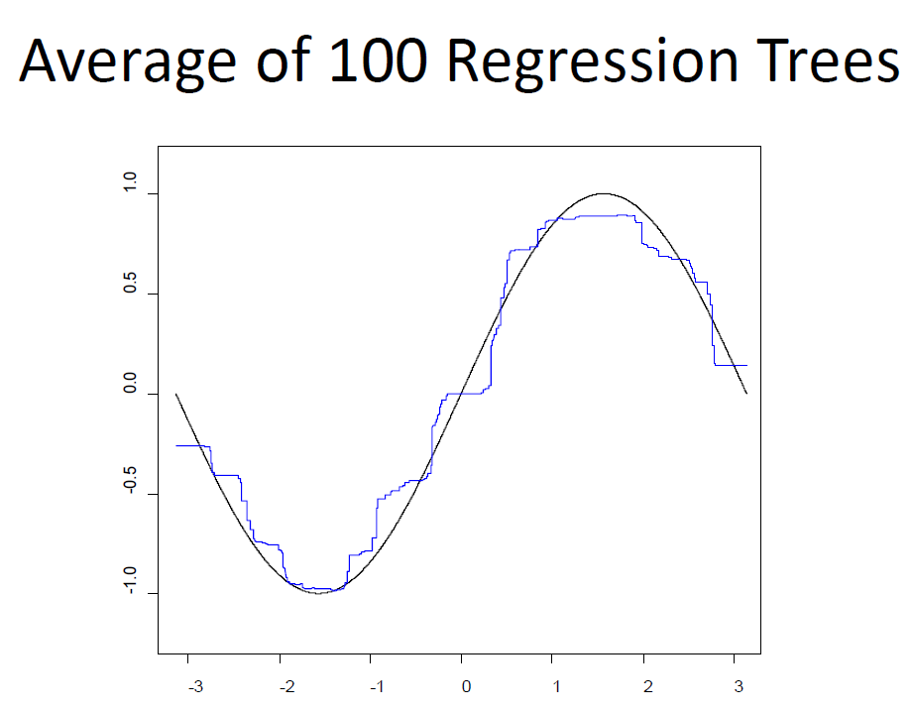
Model selection : random forest

Slide 28
Wind RF
Objective: overview of a ML use case in Thomson Reuters
5 min about AI/ML/DL
Use case: wind power production forecast in Germany (DEU)
Input data
Model selection
Optimisation
Generalisation

Slide 29
Use case 1: wind power forecast in DEU
Optimisation: choice of hyperparameters of our choosen model
Model specific: N_{T}, minimum leaf size (minLS), numPTS, number of nodes per tree, etc..
Problem specific: number of grid points
How to choose these parameters
- based on common sense and defaults values (and a lot of manual iterations)
- based on brute force search in the parameter space
- based on Bayesian optimization (bayesopt): efficient search of the parameter space / requires processing power

Slide 30
Use case 1: wind power forecast in DEU
Optimisation: choice of hyperparameters of our choosen model
Training (65)
Validation (20)
Test (15)
timeline
2015
Calibration and cross-validation
June 2018
28th June 2018
now
Test

Slide 31
Optimisation: number of grid points
Input grid (# ws params) | Training error (mape, %) | Validation error (mape, %)
2x2 (4) | 14.3 % | 19.1 %
3x3 (9) | 8.9 % | 14.6 %
4x4 (16) | 7.5 % | 14.0 %
5x5 (25) | 6.9 % | 13.3 %
6x6 (36) | 6.8 % | 13.6 %
7x7 (49) | 6.6 % | 13.4 %
8x8 (64) | 6.6 % | 13.4 %
9x9 (81) | 6.4 % | 13.6 %
10x10 (100) | 6.3 % | 13.6 %

Slide 32
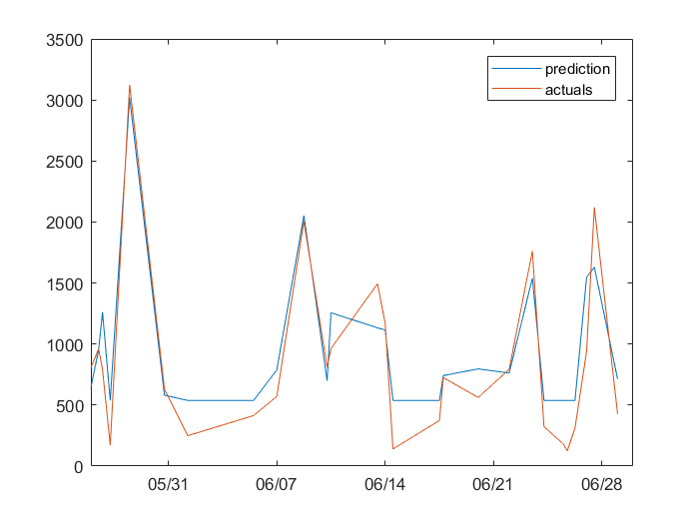
Use case 1: wind power forecast in DEU
Optimisation: choice of hyperparameters of our choosen model
# nodes | Test error (mape, %) | Validation error (mape, %)
5 | 26.9 | 26.4
15
50
150
300
600
1200
Wind power production (MWh/h)

Slide 33
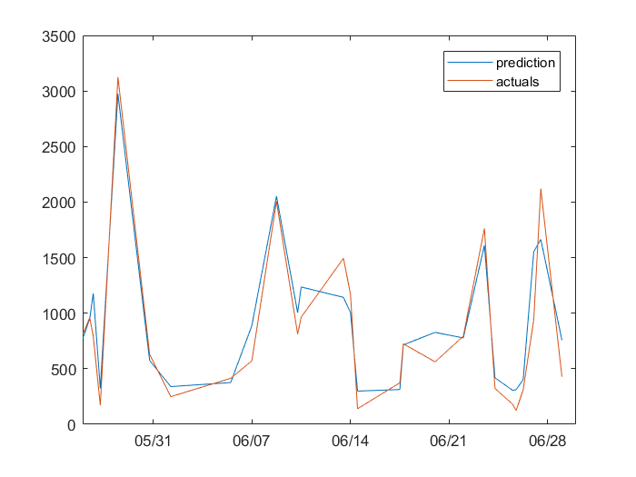
Use case 1: wind power forecast in DEU
Optimisation: choice of hyperparameters of our choosen model
# nodes | Test error (mape, %) | Validation error (mape, %)
5 | 26.9 | 26.4
15 | 19.7 | 20.2
50
150
300
600
1200
Wind power production (MWh/h)

Slide 34
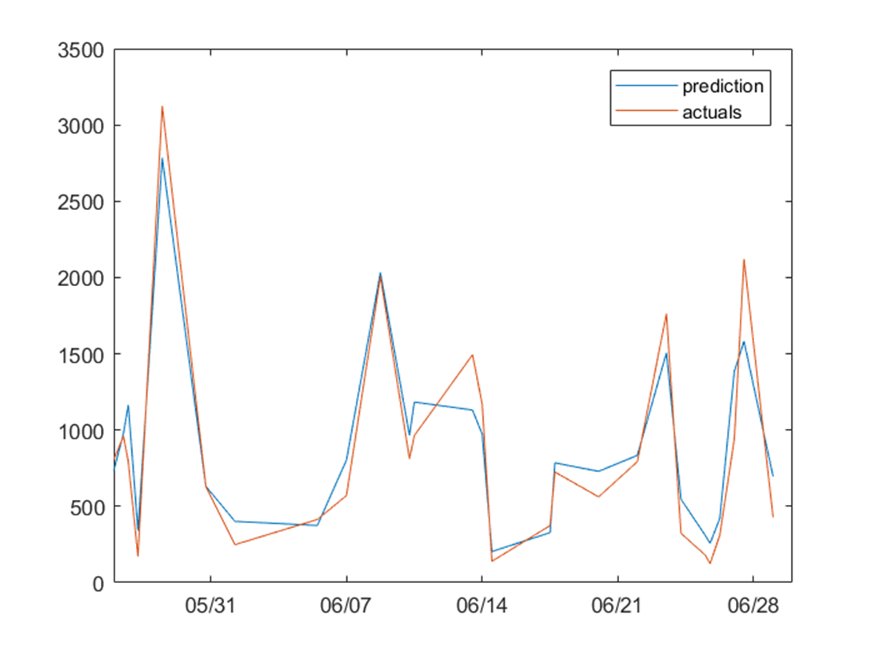
Use case 1: wind power forecast in DEU
Optimisation: choice of hyperparameters of our choosen model
# nodes | Test error (mape, %) | Validation error (mape, %)
5 | 26.9 | 26.4
15 | 19.7 | 20.2
50 | 14.9 | 16.9
150
300
600
1200
Wind power production (MWh/h)

Slide 35
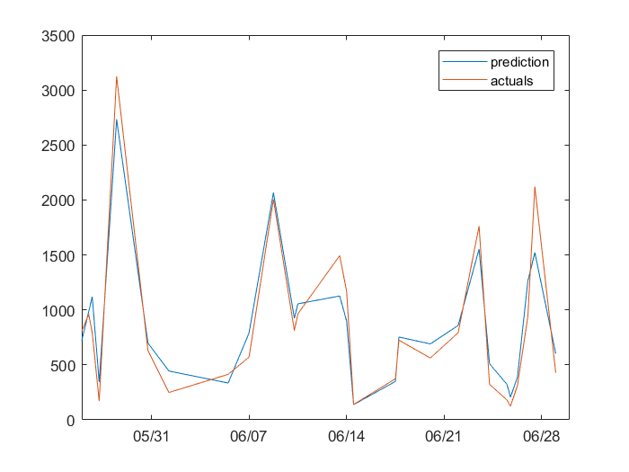
Use case 1: wind power forecast in DEU
Optimisation: choice of hyperparameters of our choosen model
# nodes | Test error (mape, %) | Validation error (mape, %)
5 | 26.9 | 26.4
15 | 19.7 | 20.2
50 | 14.9 | 16.9
150 | 11.6 | 15.4
300
600
1200
Wind power production (MWh/h)

Slide 36
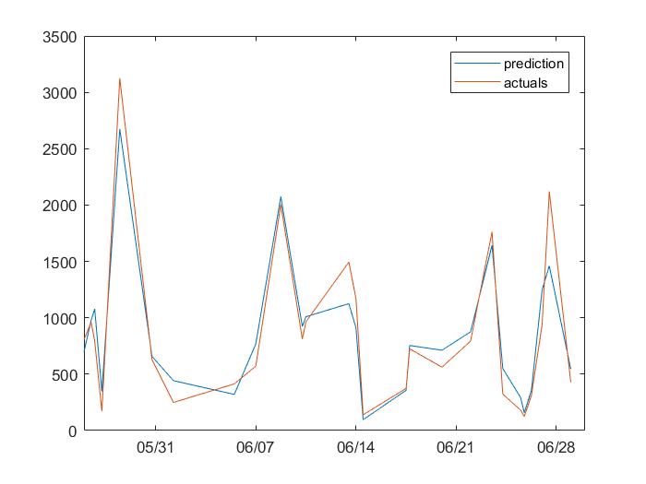
Use case 1: wind power forecast in DEU
Optimisation: choice of hyperparameters of our choosen model
# nodes | Test error (mape, %) | Validation error (mape, %)
5 | 26.9 | 26.4
15 | 19.7 | 20.2
50 | 14.9 | 16.9
150 | 11.6 | 15.4
300 | 9.6 | 14.8
600
1200
Wind power production (MWh/h)

Slide 37
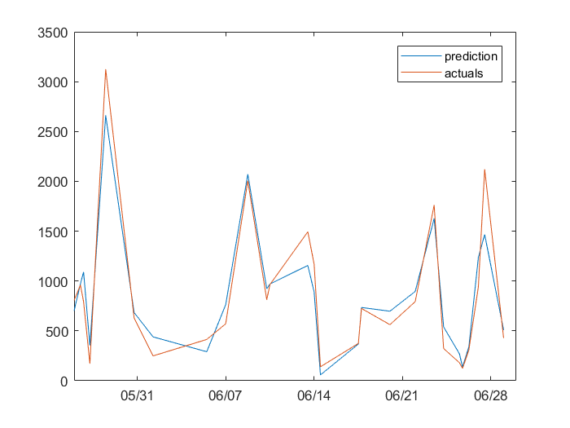
Use case 1: wind power forecast in DEU
Optimisation: choice of hyperparameters of our choosen model
# nodes | Test error (mape, %) | Validation error (mape, %)
5 | 26.9 | 26.4
15 | 19.7 | 20.2
50 | 14.9 | 16.9
150 | 11.6 | 15.4
300 | 9.6 | 14.8
600 | 7.8 | 14.6
1200
Wind power production (MWh/h)

Slide 38
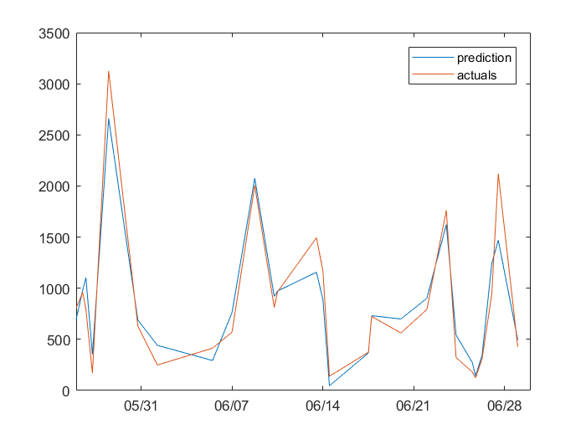
Use case 1: wind power forecast in DEU
Optimisation: choice of hyperparameters of our choosen model
# nodes | Test error (mape, %) | Validation error (mape, %)
5 | 26.9 | 26.4
15 | 19.7 | 20.2
50 | 14.9 | 16.9
150 | 11.6 | 15.4
300 | 9.6 | 14.8
600 | 7.8 | 14.6
1200 | 7.4 | 14.6
Wind power production (MWh/h)

Slide 39
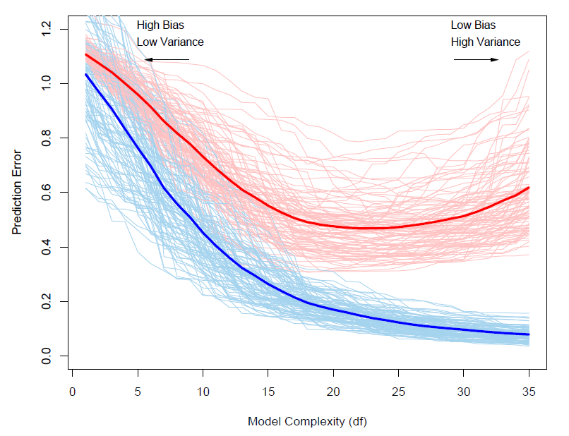
Optimisation
Bias – variance decomposition

Slide 40
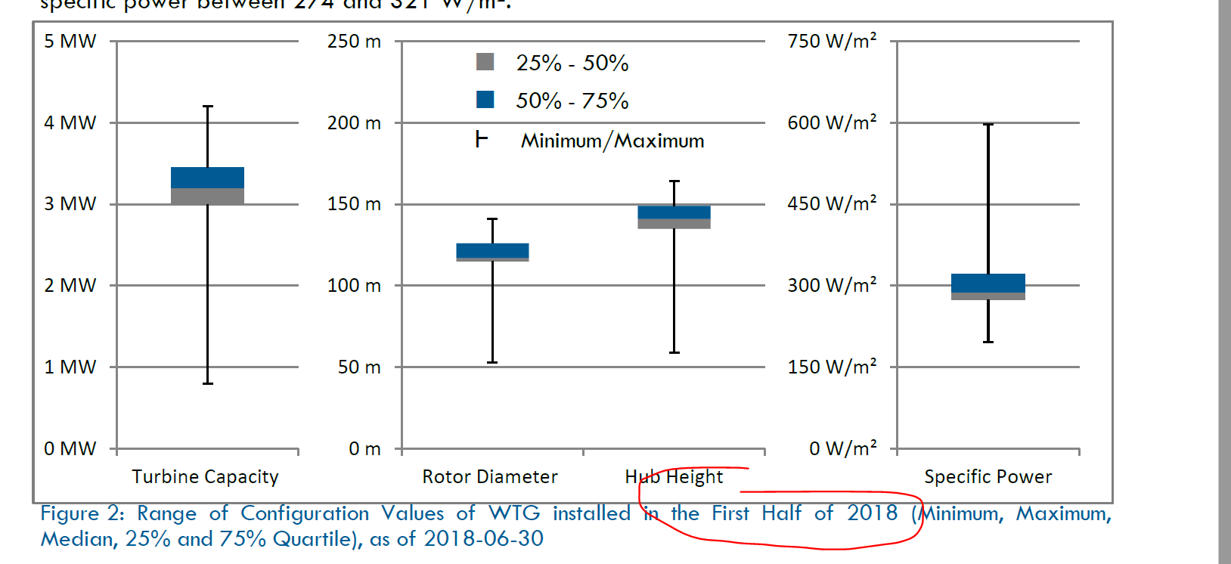
Onshore wind mills hub height
Input grid (# ws params) | Training error (mape, %) | Validation error (mape, %)
5x5 (25) 100m | 6.9 % | 13.3 %
5x5 (25) 100m + 5x5 (25) 10m | 6.6 % | 13.8 %
5x5 (25) 100m + 5x5 (25) 10m + temp (25) + pressure (25) | 6.7 % | 13.9 %
What about old wind mills ?

Slide 41
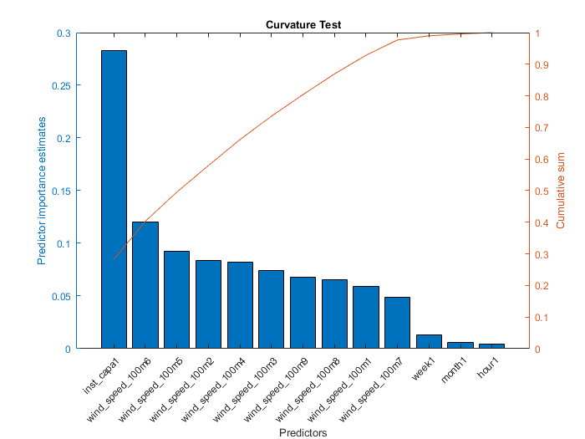
Optimisation: Predictor importance

Slide 42
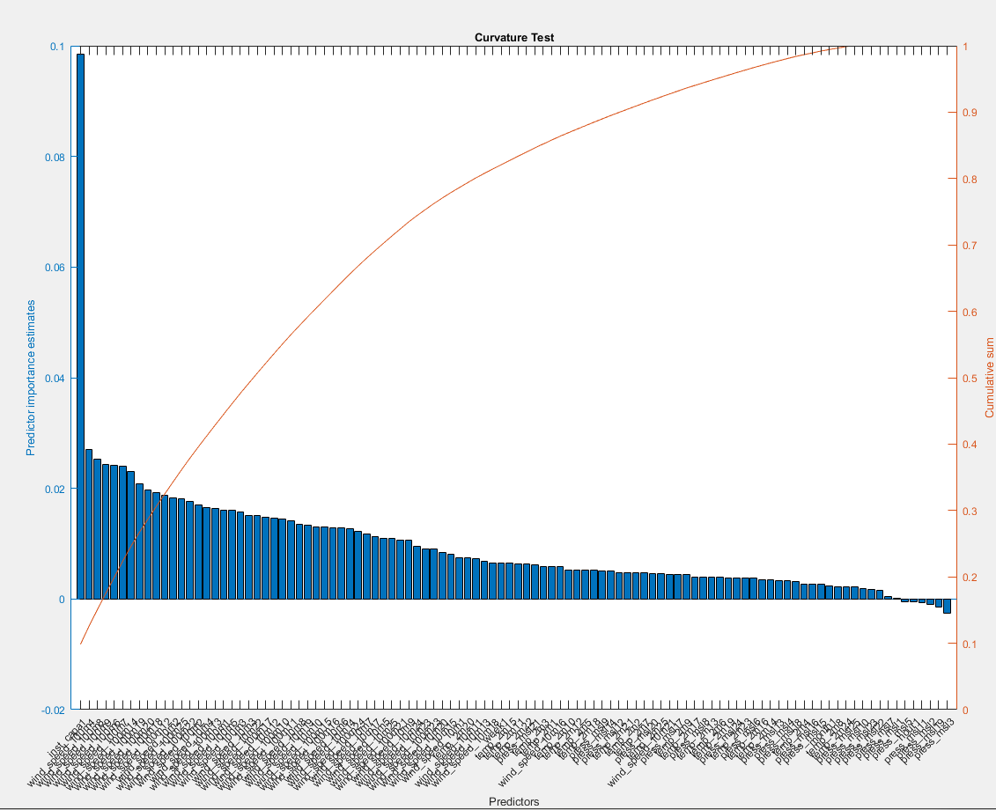
Optimisation: Predictor importance

Slide 43
Wind RF
Objective: overview of a ML use case in Thomson Reuters
5 min about AI/ML/DL
Use case: wind power production forecast in Germany (DEU)
Input data
Model selection
Optimisation
Generalisation

Slide 44
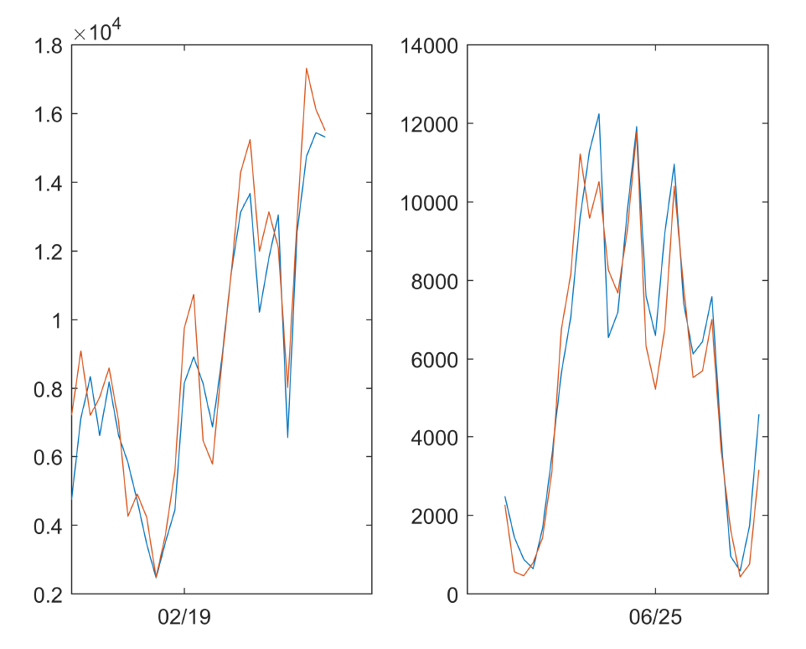
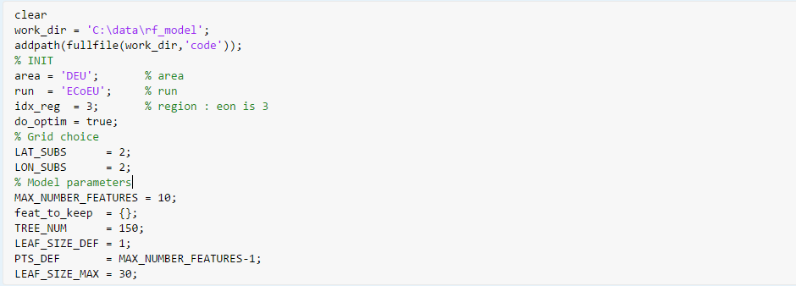
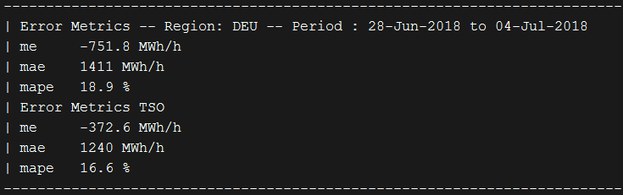
Generalisation
Optimised parameters
Results (for the public)
Results (that count) : error in test dataset vs. baseline
blue: production
orange: estimation

Slide 45
Take home message
Create a simple baseline (if you start on a new project)
Don’t underestimate the time (code) needed on gathering data / feature engineering
Less time/recursion on the model optimisation (fun and important one)
Shallow models can provide an acceptable accuracy
Deep learning models are often the most accurate, but not the ones we should use
Generalisation, generalisation, generalisation

Slide 46

Thanks

Slide 48
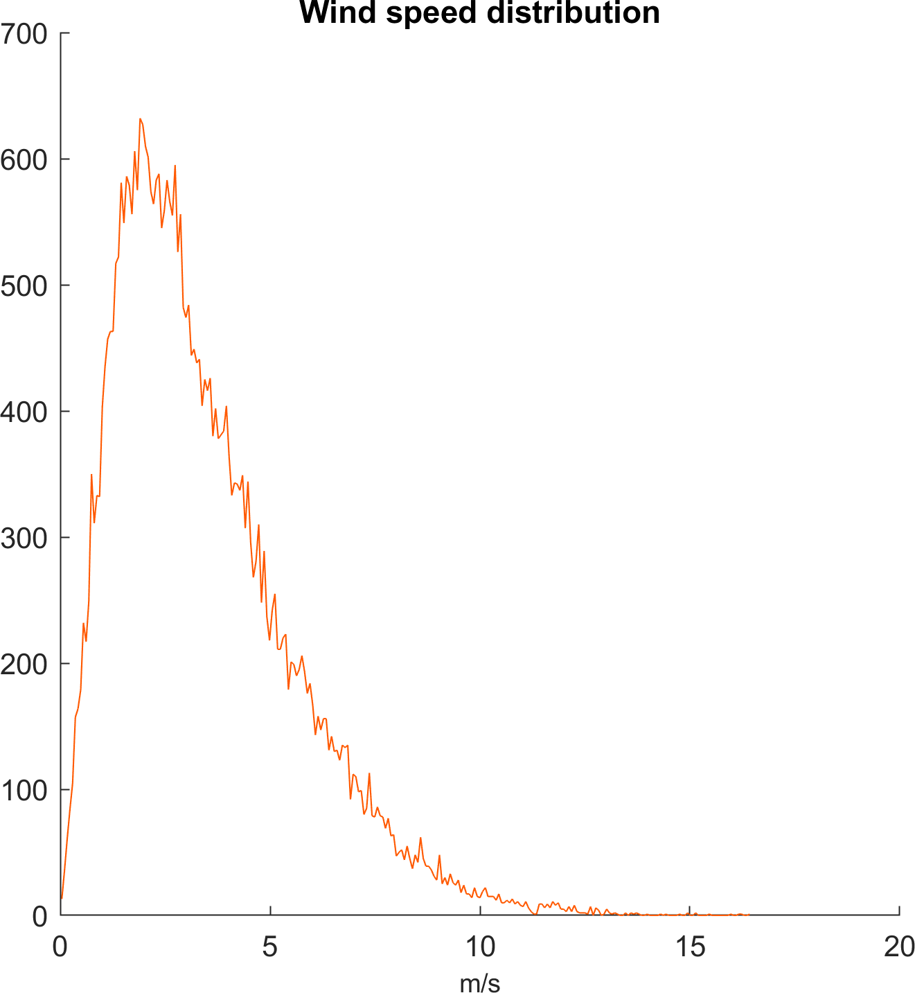
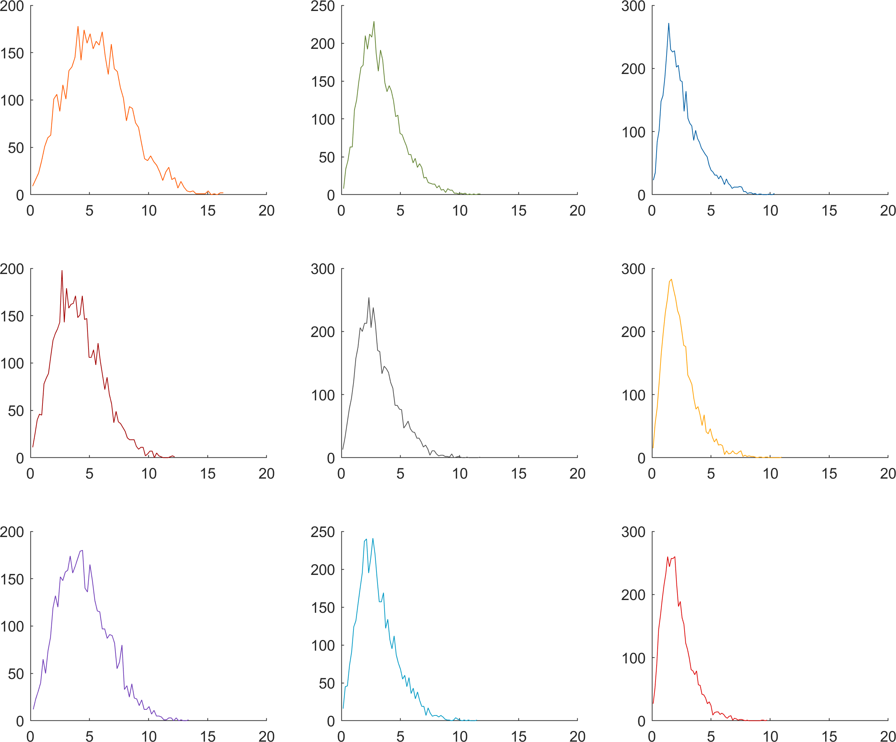
Use case 1: wind power forecast in DEU
Input data: wind speed in a 3x3 grid
Run 01 results

Slide 49
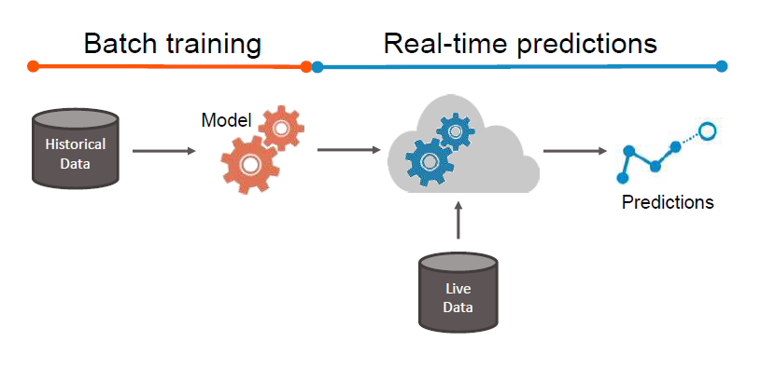
Learning Process

